Slide 1





Introduction to ASP.NET
ASP.NET, Architecture, Web Forms, MVC, Web API
ASP.NET Web Forms
Telerik Software Academy
http://academy.telerik.com

Slide 2

Table of Contents
Introduction to ASP.NET
History, Components, Frameworks
ASP.NET App Structure
Typical Files and Folders in ASP.NET Projects
ASP.NET App Lifecycle
Application Lifecycle, HTTP Modules, HTTP Handlers, Events, Controllers, Pages, …
ASP.NET Common Concepts
Classes & Namespaces, Web Sites & Web Apps
ASP.NET 5

Slide 3
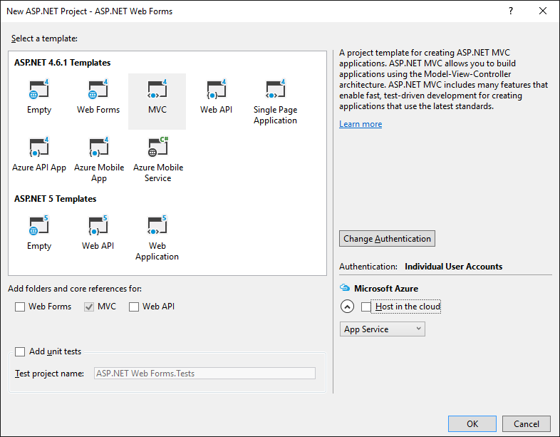
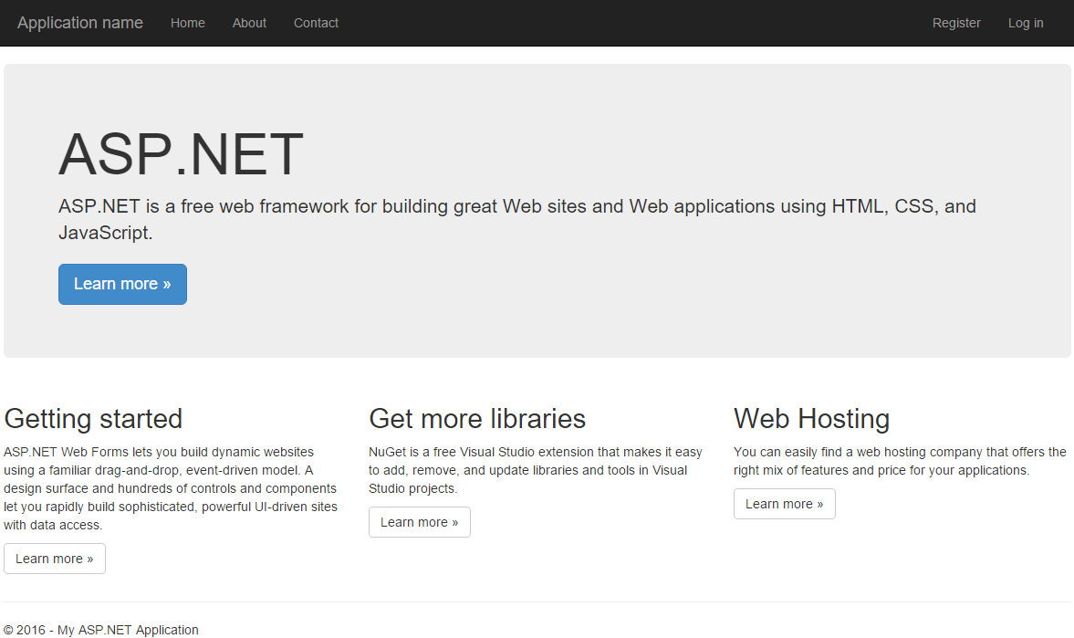

Introduction to ASP.NET

Slide 4

History of ASP.NET
At the beginning of Internet (up to 1997)
CGI, ISAPI (for C, C++), PHP
Classic / Legacy ASP (1997-2002)
Based on VB Script, COM, ADO
ASP.NET 1.0 (2002, January 16) – with .NET 1.0
ASP.NET 1.1 (2003-2005) – based on .NET 1.1
ASP.NET 2.0 (2005-2007) – based on .NET 2.0
ASP.NET 3.5 (2007-2009) – LINQ to SQL, MVC
ASP.NET 4.0 (2010) – Entity Framework, MVC
ASP.NET 4.5 (2012) – One ASP.NET (info)
ASP.NET 4.6 (2015) – HTTP/2, Roslyn, fixes
ASP.NET 5 (expected 2016) – Redesigned (info)
ASP.NET

Slide 5
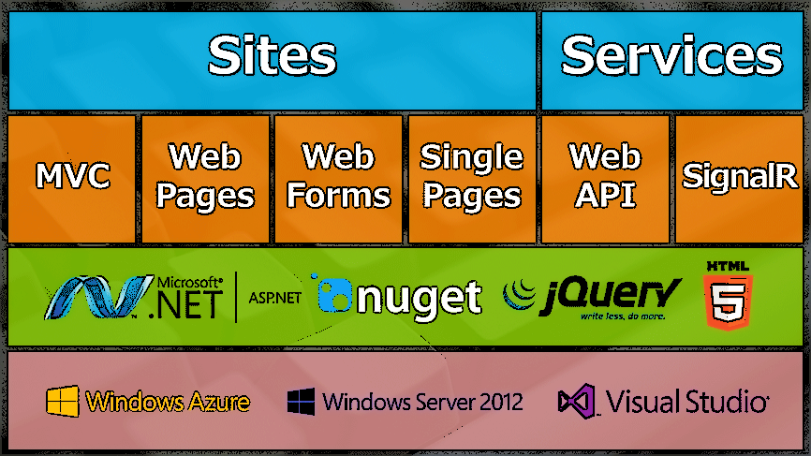
What is ASP.NET?
ASP.NET is a stack of technologies to create web sites, web services and web applications

Slide 6
ASP.NET: Web Forms vs. MVC
ASP.NET has two major frameworks for web application development
ASP.NET Web Forms (read more)
The traditional component-based approach
Mixes the presentation and presentation logic
ASP.NET MVC (read more)
Modern approach, more clear and flexible
MVC architecture, like Ruby-on-Rails and Django
Testable and easy to use

Slide 7
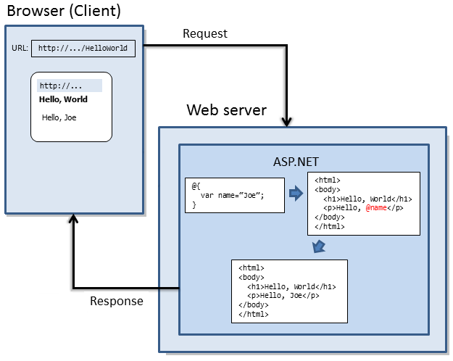
ASP.NET: Web Pages, Web API
ASP.NET Web Pages (read more)
Lightweight framework to combine C# code with HTML to create dynamic web content
Similar to PHP
Uses the "Razor"
ASP.NET Web API (read more)
Framework for building RESTful Web services
Write C# code to handle HTTP requests in REST style (GET / POST / PUT / DELETE requests)
Return JSON / XML as result

Slide 8
ASP.NET: SPA, SignalR
Single Page Applications (SPA) (read more)
Combine ASP.NET Web API with client-side JS
Write a HTML5 single page apps with AngularJS / Knockout.js / other JS client-side framework
Client HTML5 code consumes Web API services
SignalR (read more)
Real-time communication between client (JS) and server (C#) over HTTP through Web Sockets
Server C# code can invoke JS functions at the client
Client JS code can invoke C# methods at the server

Slide 9
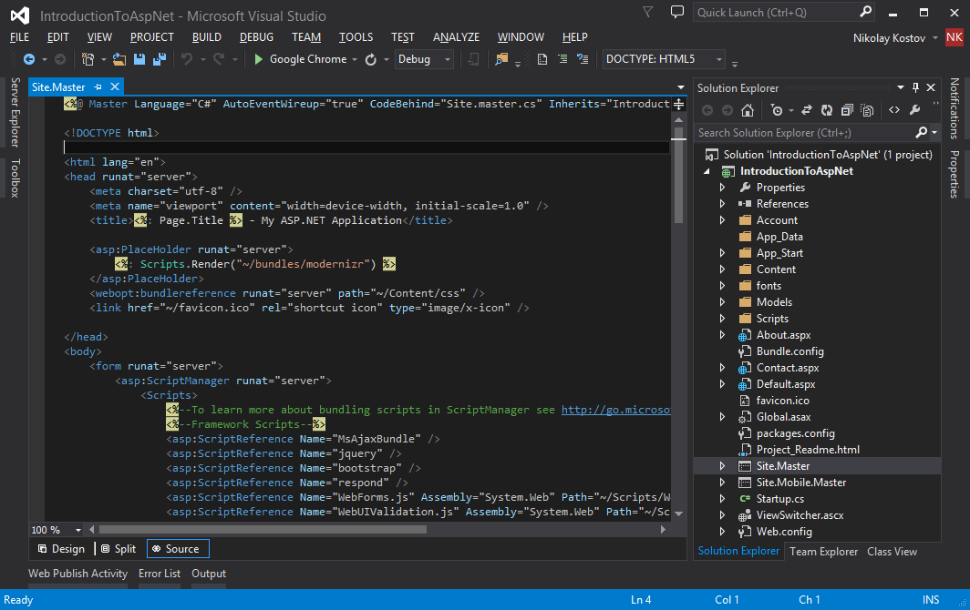
Simple Web Forms App
Live Demo

Slide 10
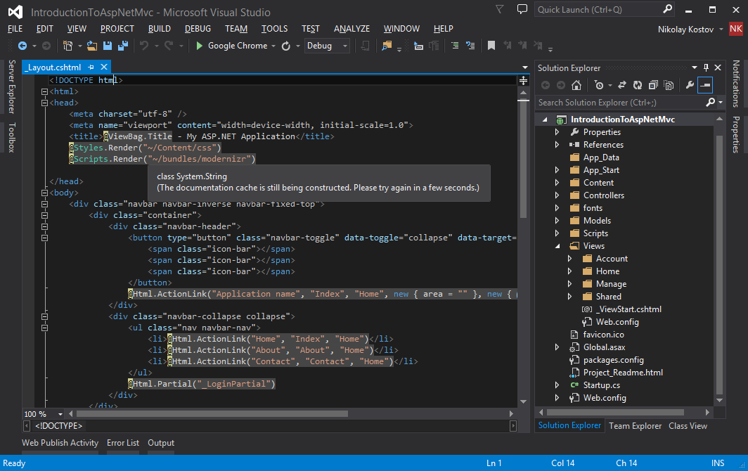
Simple MVC App
Live Demo

Slide 11
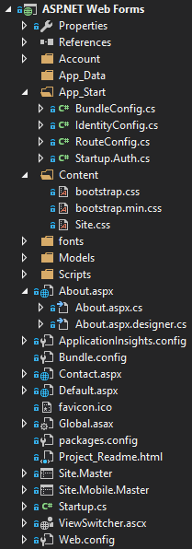
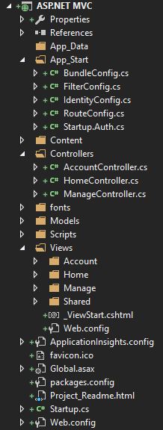
ASP.NET Application Structure
Typical Application Structure in ASP.NET

Slide 12
ASP.NET App Structure
App_Start
BundleConfig / RoutesConfig / IdentityConfig / Startup.cs (OWIN)
App_Data
Web.config
Global.asax
Content and Content\themes
Scripts, img, fonts
Models / Views / Controllers
Site.Master / Site.Mobile.Master

Slide 13
App_Start
The App_Start folder
Holds global configuration logic
Classes that are used at application start-up
BundleConfig.cs (read more)
Combines and optimizes CSS and JS files
FilterConfig.cs (read more)
Configures filters in MVC / Web API apps
Configures pre-action and post-action behavior to the controller's action methods

Slide 14
App_Start (2)
RouteConfig.cs (read more)
Configures URL patterns and their handlers
Maps user-friendly URLs to certain page / controller
IdentityConfig.cs / Startup.Auth.cs
Configures the membership authentication
Users, roles, login, logout, user management
OAuth login (cross-sites login, read more)
Facebook / Twitter / Microsoft / Google login

Slide 15
App_Data
The App_Data directory holds the local data files of the Web application
E.g. MyWebApp.mdf + MyWebApp.ldf
E.g. Countries.xml
The SQL Server "Local DB" (read more)
Local .mdf + .ldb files, attached at startup
SQL Server process started on demand
Database created on demand (if missing)
Great for development and testing

Slide 16
Web.config
Web.config is web app's configuration file
Holds settings like DB connection strings, HTTP handlers, modules, assembly bindings
Can hold custom application settings, e.g. credentials for external services
Changes in Web.config do not require rebuild
You may have several Web.config files
One global for the application
Several for different folder in the application

Slide 17
Web.config (2)
Web.config inherits from the global Web.config and from machine.config
Global settings for all applications on the server
Web.Debug.config
Local settings for debugging
E.g. local database instance for testing
Web.Release.config
Production settings for real world deployment
C:\Windows\Microsoft.NET\Framework\v4.0.30319\Config\machine.config

Slide 18
Web.config – Example
<?xml version="1.0" encoding="utf-8"?>
<configuration>
<configSections>
<section name="entityFramework" type="System.Data.Entity.Internal.ConfigFile.EntityFrameworkSection, EntityFramework, Version=6.0.0.0, Culture=neutral, PublicKeyToken=b77a5c561934e089" requirePermission="false" />
</configSections>
<connectionStrings>
<add name="DefaultConnection" connectionString="Data Source=(LocalDb)\v11.0;AttachDbFilename=|DataDirectory|\aspnet.mdf;Initial Catalog=aspnet;Integrated Security=True" providerName="System.Data.SqlClient" /> </connectionStrings>
<appSettings>
<add key="webpages:Enabled" value="false" />
<add key="ClientValidationEnabled" value="true" />
<add key="UnobtrusiveJavaScriptEnabled" value="true" />
…
</appSettings>
<system.web>
<compilation debug="true" targetFramework="4.6.1" />
…
</system.web>
<system.webServer> … </system.webServer>
<runtime> … </runtime>
<entityFramework> … </entityFramework>
</configuration>

Slide 19
Global.asax
Global.asax defines the HTTP application
Defines global application events like
Application_Start
Application_BeginRequest
Application_EndRequest
Application_Error
…
Typically invokes BundleConfig, RouteConfig, FilterConfig, etc.

Slide 20
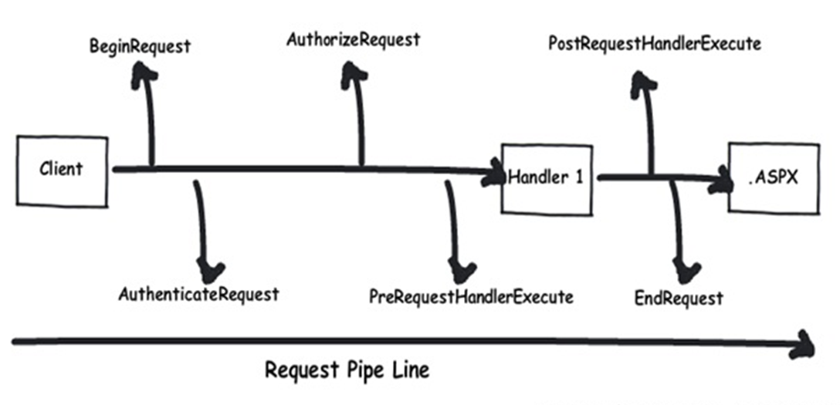
ASP.NET App Lifecycle
Application Lifecycle, HTTP Modules, Handlers, Events, Controllers, Pages, …

Slide 21
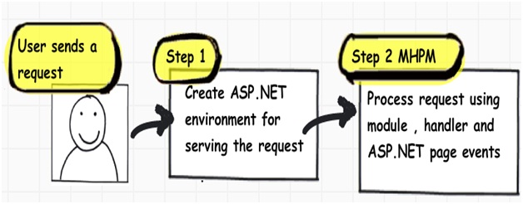
ASP.NET App Lifecycle
Step 1 creates Application object, Request, Response and Context objects to process the request
Step 2 series of events called MHPM for short – Module, Handler, Page, Module Events
* Source: http://www.codeproject.com/Articles/73728/ (by Shivprasad Koirala)

Slide 22
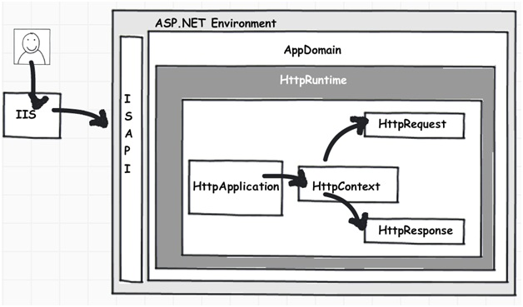
ASP.NET App Lifecycle (2)
aspnet_isapi.dll
(created only the first time)
Application Pools
in Global.asax
* Source: http://www.codeproject.com/Articles/73728/

Slide 23
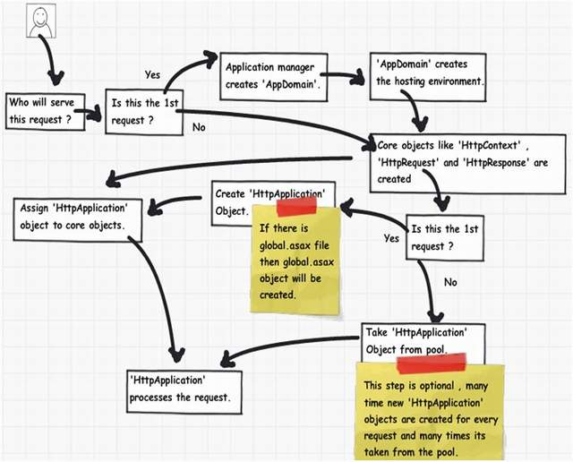
ASP.NET App Lifecycle (3)
* Source: http://www.codeproject.com/Articles/73728/

Slide 24
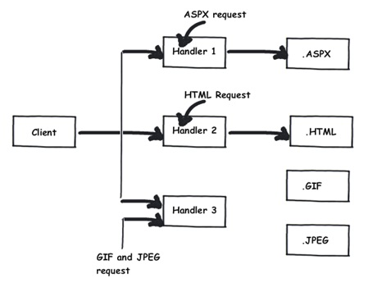
HttpHandler
HttpHandler – injects logic based in file extensions
HttpHandler is an extension based processor
* Source: http://www.codeproject.com/Articles/73728/

Slide 25
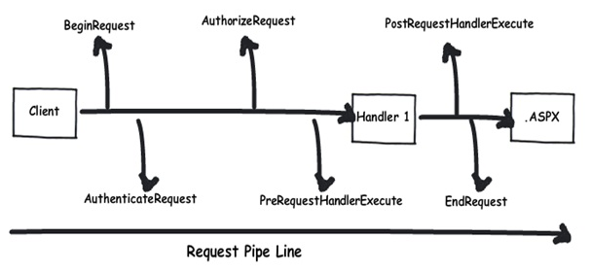
HttpModule
HttpModule – injects logic in the events of ASP.NET pipleline
HttpModule is an event based processor
* Source: http://www.codeproject.com/Articles/73728/

Slide 26
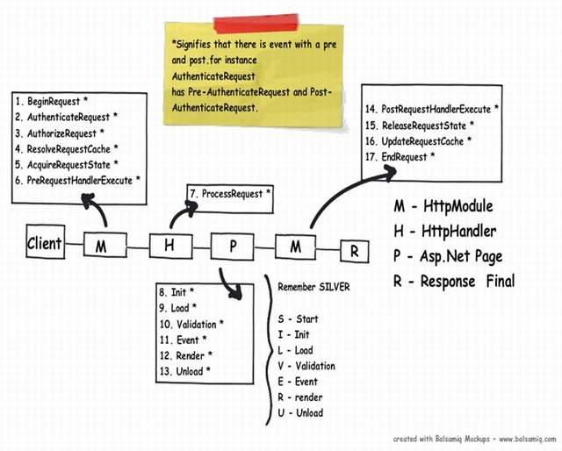
ASP.NET App Lifecycle (4)
* Source: http://www.codeproject.com/Articles/73728/

Slide 27
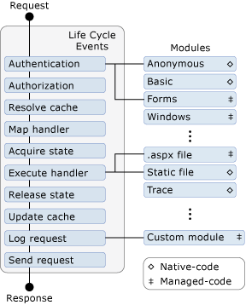
Application Lifecycle Events
HttpApplication have a complex pipeline to the process HTTP requests (read more)
Application_Start
Application_End
Application_Error
Application_BeginRequest
Application_EndRequest
Application_PreSendRequestHeaders
Application_ResolveRequestCache
Application_PreRequestHandlerExecute

Slide 28
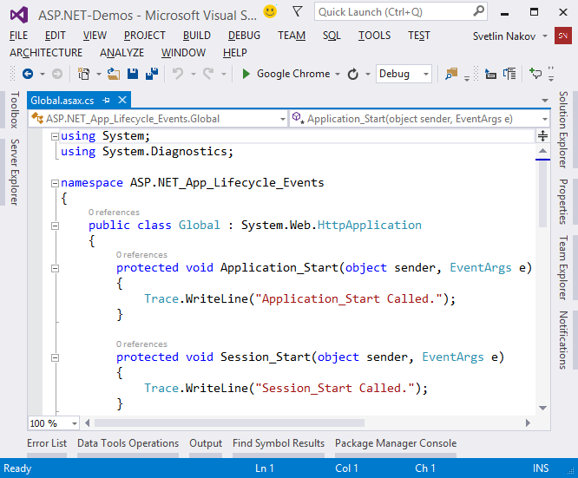
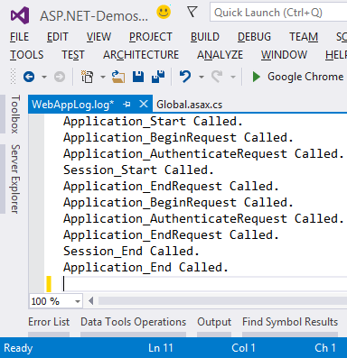
App Lifecycle Events
Demo

Slide 29
HTTP Handlers
A "HTTP handler" is a process / C# code that responses to HTTP requests
Sample HTTP handler in C#:
Handler registration in Web.config:
public class TelerikAcademyHttpHandler : IHttpHandler
{
public void ProcessRequest(HttpContext context)
{ context.Response.Write("I am а HTTP handler."); }
public bool IsReusable
{ get { return false; } }
}
<configuration><system.webServer><handlers>
<add verb="*" path="*.academy" name="Academy's HTTP handler"
type="TelerikAcademyHttpHandler"/>
</handlers></system.webServer></configuration>

Slide 30
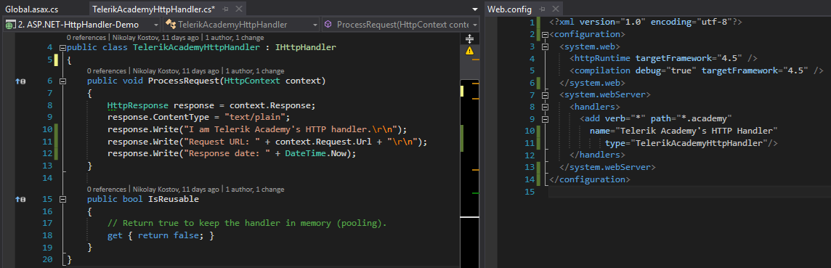
Writing a HTTP Handler
Demo

Slide 31
HTTP Modules
HTTP modules can customize requests for resources that are serviced by ASP.NET
It can intercept all HTTP requests and apply a custom logic
Steps to create an HTTP Module
Implement the IHttpModule interface
Subscribe to events you want to intercept, e.g. HttpApplication.BeginRequest
Register the HTTP module in Web.config in the <modules> section

Slide 32
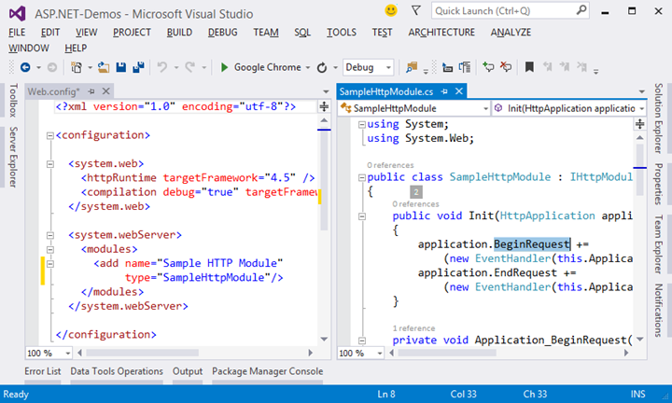
Writing a HTTP Module
Demo

Slide 33
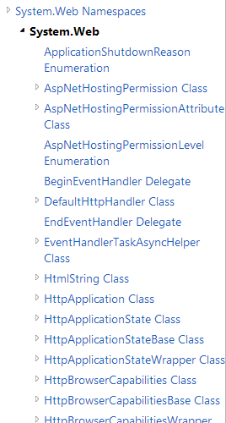
ASP.NET Common Concepts
Major Classes, Namespaces, Web Sites, Web Apps

Slide 34
ASP.NET Namespaces
Major ASP.NET (4.6) namespaces
System.Web
Web application main classes like HttpApplication, HttpContext, HttpRequest, HttpResponse, HttpSessionState, …
System.Web.Mvc
MVC classes and framework components
System.Web.UI (.WebControls)
Web Forms UI controls (like Button and Label)

Slide 35
ASP.NET Classes
HttpApplication
Base class for the ASP.NET Web apps (inherited in Global.asax)
HttpContext
Encapsulates all HTTP-specific information about an individual HTTP request
HttpRequest
Encapsulates an HTTP request
HttpResponse
Encapsulates an HTTP response

Slide 36
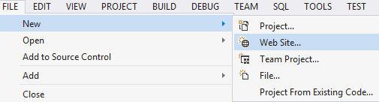
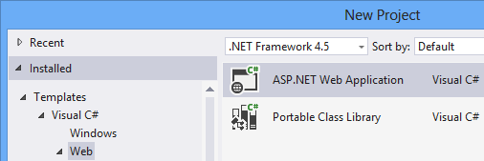
Web Site vs. Web Application
Web Sites in VS
No project file (.csproj / .sln)
Code compiled dynamically at the Web server
Can be precompiled (into multiple assemblies)
Web Apps in VS
Have project file (like any C# project)
Compilation produces an assembly: bin\*.dll
Web apps are recommended (read more)

Slide 37
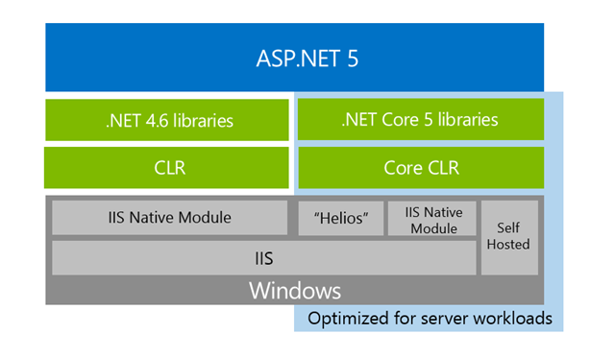
ASP.NET 5
The redesign of ASP.NET

Slide 38
ASP.NET 5
Open-source cross-platform framework for building modern cloud-based Web applications
Modular components with minimal overhead
Cross-platform (runs on Windows, Mac, Linux)
Rewritten from the ground up
A lot of legacy code removed from the 15-years-old ASP.NET
No longer based on System.Web.dll
Based on a set of granular and well factored NuGet packages

Slide 39
Main ASP.NET 5 Improvements
New light-weight and modular HTTP request pipeline
Ability to host on IIS or self-host in your own process
Built on .NET Core
Ships entirely as NuGet packages
Integrated support for creating and using NuGet packages
Single aligned web stack for Web UI and Web APIs
Cloud-ready environment-based configuration
Built-in support for dependency injection
New tooling that simplifies modern web development
Build and run cross-platform ASP.NET apps on Windows, Mac and Linux
Open source and community focused

Slide 40
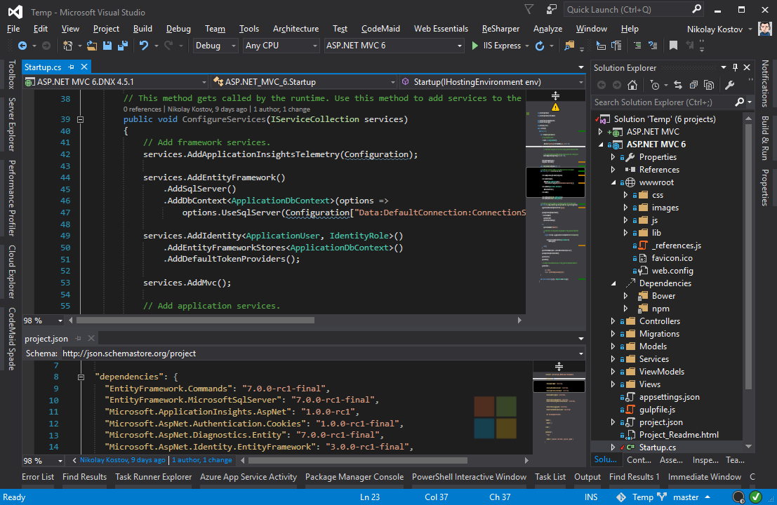
ASP.NET 5 (MVC 6)
Live Demo

Slide 41
Introduction to ASP.NET
http://academy.telerik.com

Slide 42




Free Trainings @ Telerik Academy
C# Programming @ Telerik Academy
csharpfundamentals.telerik.com
Telerik Software Academy
academy.telerik.com
Telerik Academy @ Facebook
facebook.com/TelerikAcademy
Telerik Software Academy Forums
forums.academy.telerik.com

